Slide 1

Chapter:1 Semiconductor and Diode Theory
03107101 : BASIC ELECTRONICS
Compiled by
PROF. DURVESH ASLAM
Assistant Professor
Faculty of Engineering and Technology
Parul University

Slide 2
Contents
Conductors, Semiconductors
Silicon crystals , Intrinsic semiconductors
Two types of flow
Doping a semiconductor
Two types of extrinsic semiconductors
The unbiased diode
Forward bias, Reverse bias, Breakdown
Energy levels, The energy hill
Barrier potential and temperature
Reverse-biased diode

Slide 3
Conductor
A material that allows current to flow
Examples: copper, silver, gold
The best conductors have one valence electron

Slide 4
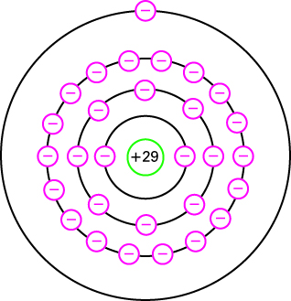
Atomic Structure of Copper

Slide 5
Core
Nucleus and inner orbits
Valence or outer orbit controls electrical properties
Core of copper atom has net charge of + 1

Slide 6
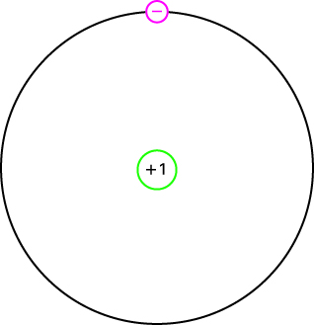
Core of Copper

Slide 7
Free Electron
The attraction between core and valence electron is weak
An outside force easily dislodges a free electron from an atom

Slide 8
Semiconductor
An element with electrical properties between those of a conductor and those of an insulator.

Slide 9
Semiconductor Examples
Semiconductors typically have 4 valence electrons
Germanium
Silicon

Slide 10
Core diagrams for copper and silicon:
One valence electron
Four valence electrons
Copper
Silicon
+1
+4
The nucleus plus the inner electron orbits

Slide 11
Silicon atoms in a crystal share electrons.
Valence saturation: n = 8
Because the valence electrons are bound, a silicon
crystal at room temperature is almost a perfect insulator.

Slide 12
Inside a silicon crystal
Some free electrons and holes are created by thermal energy.
Other free electrons and holes are recombining.
Recombination varies from a few nanoseconds to several microseconds.
The time between creation and recombination of a free electron and a hole is called the life time.

Slide 13
Silicon crystals are doped to
provide permanent carriers.
Free electron
Hole
(n type)
(p type)
Pentavalent dopant
Trivalent dopant

Slide 14
Intrinsic Semiconductor
A pure semiconductor
A silicon crystal is intrinsic if every atom in the crystal is a silicon atom
Two types of current flow: electrons and holes

Slide 15
Doping
Adding impurity atoms to an intrinsic crystal to alter its electrical conductivity
A doped semiconductor is called an extrinsic semiconductor

Slide 16
This crystal has been doped with a pentavalent impurity.
The free electrons in n type silicon support the flow of current.

Slide 17
This crystal has been doped with a trivalent impurity.
The holes in p type silicon support the flow of current.
Note that hole current is opposite in direction to electron current.

Slide 18
Semiconductors in Summary
The most popular material is silicon.
Pure crystals are intrinsic semiconductors.
Doped crystals are extrinsic semiconductors.
Crystals are doped to be n type or p type.
An n type semiconductor will have a few minority carriers (holes).
A p type semiconductor will have a few minority carriers (electrons).

Slide 19
A semiconductor can be doped to have an excess of free electrons or holes
The two types of doped semiconductors are n type and p type

Slide 20
Doping a crystal with both types
of impurities forms a pn junction diode.
Junction
P
N
Negative
ion
Positive
ion
Some electrons will cross the junction and fill holes.
A pair of ions is created each time this happens.
As this ion charge builds up, it prevents further
charge migration across the junction.

Slide 21
The pn barrier potential
Electron diffusion creates ion pairs called dipoles.
Each dipole has an associated electric field.
The junction goes into equilibrium when the barrier potential prevents further diffusion.
At 25 degrees C, the barrier potential for a silicon pn junction is about 0.7 volts.

Slide 22
Each electron that migrates across the
junction and fills a hole effectively
eliminates both as current carriers.
P
N
Depletion layer
This results in a region at the junction that is
depleted of carriers and acts as an insulator.

Slide 23
Forward bias
The carriers move toward the junction
and collapse the depletion layer.
If the applied voltage is greater than
the barrier potential, the diode conducts.

Slide 24
Reverse bias
The carriers move away from the junction.
The depletion layer is reestablished
and the diode is off.

Slide 25
Diode bias
Silicon diodes turn on with a forward bias of approximately 0.7 volts.
With reverse bias, the depletion layer grows wider and the diode is off.
A small minority carrier current exists with reverse bias.
The reverse flow due to thermal carriers is called the saturation current.

Slide 26
Diode breakdown
Diodes cannot withstand extreme values of reverse bias.
At high reverse bias, a carrier avalanche will result due to rapid motion of the minority carriers.
Typical breakdown ratings range from 50 volts to 1000 volts.

Slide 27
Energy levels
Extra energy is needed to lift an electron into a higher orbit.
Electrons farther from the nucleus have higher potential energy.
When an electron falls to a lower orbit, it loses energy in the form of heat, light, and other radiation.
An LED is an example where some of the potential energy is converted to light.

Slide 28
Energy Hill
Barrier potential of a diode
Electrons need sufficient energy to cross the junction
An external voltage source that forward biases the diode provides energy

Slide 29
The p side of a pn junction has trivalent
atoms with a core charge of +3. This core
attracts electrons less than a +5 core.
Abrupt junction
Conduction band
Energy
Valence band
P-side
N-side
In an abrupt junction, the p side bands
are at a slightly higher energy level.
Real diodes have a gradual change from one material
to the other. The abrupt junction is conceptual.

Slide 30
Energy bands after the depletion layer has formed
Conduction band
Energy
Energy hill
Valence band
P-side
N-side
To an electron trying to diffuse across the junction,
the path it must travel looks like an energy hill. It
must receive the extra energy from an outside source.

Slide 31
Junction temperature
The junction temperature is the temperature inside the diode, right at the pn junction.
When a diode is conducting, its junction temperature is higher than the ambient.
There is less barrier potential at elevated junction temperatures.
The barrier potential decreases by 2 mV for each degree Celsius rise.

Slide 32
Reverse diode currents
Transient current occurs when reverse voltage changes.
I_{S}, the saturation or minority-carrier current, doubles for each 10 degree Celsius rise in temperature. It is not proportional to reverse voltage.
The surface of a crystal does not have complete covalent bonds. The holes that result produce a surface-leakage current that is directly proportional to reverse voltage.

